Slide 1
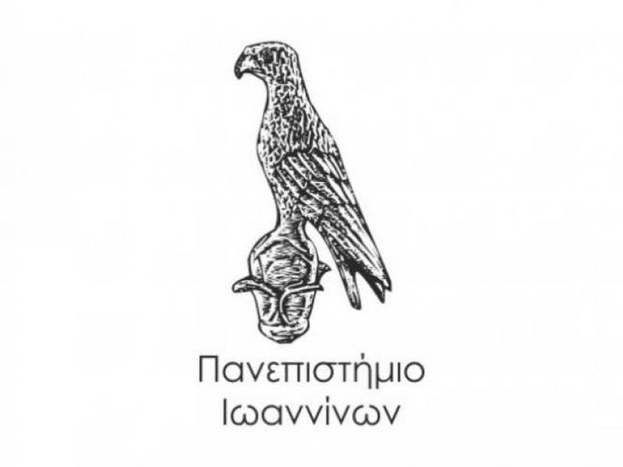
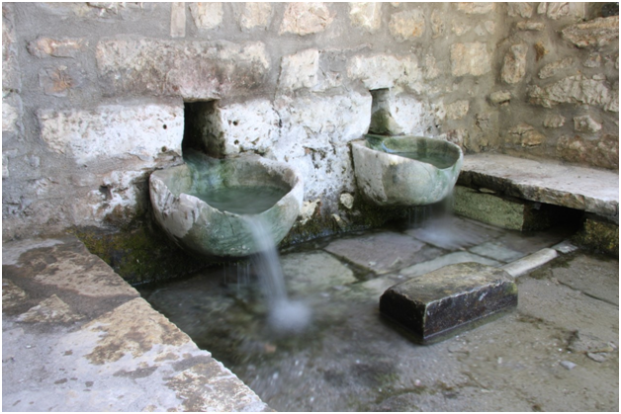
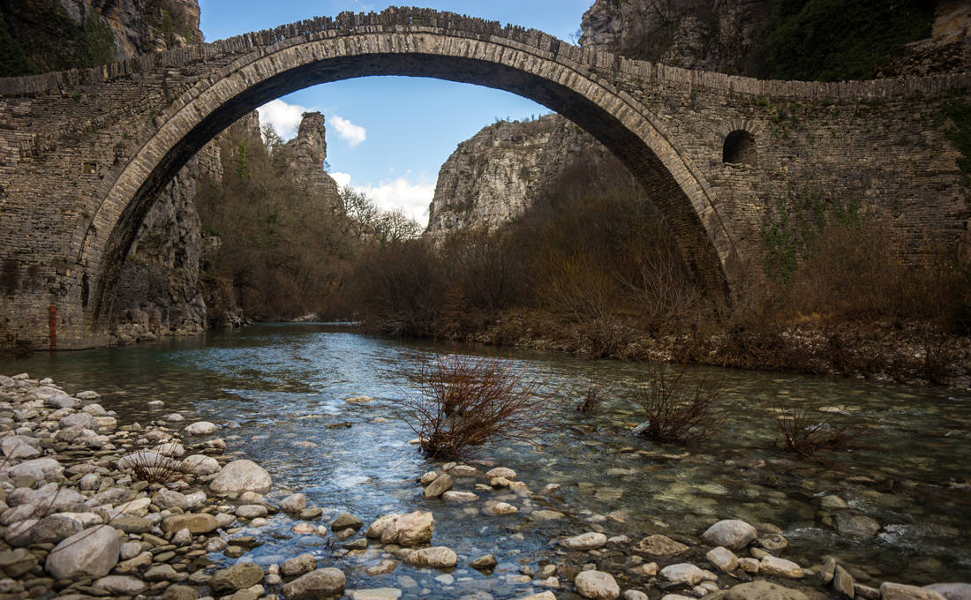
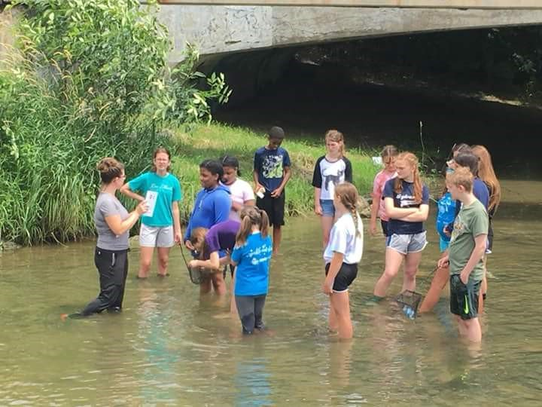
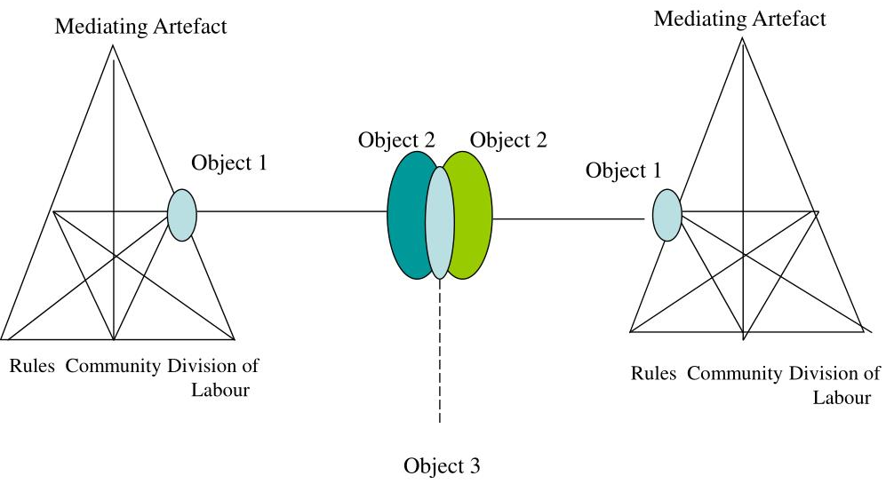
UNIVERSITY OF IOANNINA
An integrated study on Environment – Culture – Tourism and Education.
Following the roads of water in Epirus Region
PROUSKA KONSTANTINA
POTSIKAS MICHAIL
PLAKITSI KATERINA
UNIVERSITY OF IOANNINA, GREECE
k.prouska@uoi.gr
m.potsikas@uoi.gr
kplakits@uoi.gr
Environmental Education – Education for Sustainability (Study of aquatic ecosystems – Sustainable Management of natural and cultural resources – Connection of the ecosystem with local communities and culture)
Developing education material for Nature and the Environment (The material and nonmaterial culture of aquatic ecosystems). Regional Student Engaging Museums (RSEMs): A Cultural Historical Activity Theory (CHAT) Approach.
Introduction
The wetlands are considered as the ark of civilization.
The cultural routes of Epirus is the “quality leap from technical works to works life” and is the first organized effort of sustainable development focusing on monuments. The focus on the relationship between the aquatic environment, sustainability and material monuments, museums and intangible cultural elements (and the interaction of sustainable management) is a new issue in the international arena bibliography.
The main innovation of this co-research study is to draw the attention of the new generation in the sustainable management of water ecosystems by making known the state of water, existing pollution and the interaction of cultural monuments with them. Thus, facilitating agency and active citizenship towards expanding school curriculum and trigger local community engagement.
"Water shapes specific Spaces, supports Economies, generates Ideas and Poetry. With soil and water, man builds his house.
With flour and water, his bread. All Cultures start from water! "(G. Ch. Chourmouziadis).
The methods of the research
Application of mixed methods within a Participatory Action Research approach is proposed. Thus, our methodology includes a combination of methods, field research and techniques of collecting measurements and quantitative data. With CHAT as a suitable interdisciplinary and robust theoretical framework, the research methods of this study include data triangulation, observer triangulation and methodological triangulation.
Objectives
Quantitative
1) To measure the physical / chemical / biological quality characteristics of aquatic ecosystems: Kalamas river and Lake Pamvotida.
2) To describe the biodiversity, flora and fauna of the two ecosystems.
3) To map the natural path of water and the path of culture - the road of bridges - the road of ancient theaters.
Qualitative
a) Highlighting the teaching methods and teaching approaches of teachers in non-formal learning environments and formally, searching for the best combination and reflection.
b) Investigation of students' emotional, cognitive and moral development.
c) Cognitive changes, acquisition of concepts of environment, sustainability and culture, complex thinking and communication.
d) The awareness of children and consequently the local community about the values, importance and reserves of our cultural and natural environment.
e) Utilization of data of material and intangible cultural elements.
f) Development of students' individual and social skills.
g) Strengthening the bonds-relationships between students, but also between students and teachers.
Theoretical background
In figure 1 the object is depicted with an oval indicating that object-oriented actions are always characterized by ambiguity, surprise, interpretation, sense making, and potential for change. (Engeström 1999)
Figure 1. Second generation activity theory model
(Engeström 1987)
The aim of research
(a) research into materials, monuments, museums and intangible cultural elements related to materials followed by aquatic ecosystems (waterways – bridges - settlements etc.) / capitalization of studies and
(b) research in aquatic environments of exceptional importance for Epirus (lakes - rivers, etc.). Interaction research sustainable management of aquatic ecosystems through the sustainable use of materials used historically or (re) used in the local community and culture.
c) to develop a transformation model of research results towards a diversified tourism product
d) to communicate scientific results / diversification of tourism product and to enrich experience through tourism information and promotion centres, diffusion of knowledge, seminars and training.
Third generation activity theory intends to develop conceptual tools to understand dialogues, multiple perspectives, and networks of interacting activity systems.
Second generation framework is expanded through dialogicality and multivoicedness.
Figure 2. A minimal model for third generation of activity theory
(Engeström 1999)
Developmental Work Research (DWR)methodology
Investigating the barriers and the links between individual and social dimensions of learning and knowledge creation.
Figure 3: Sequence of learning actions in an expansive learning cycle
(Engeström, 1999b, p. 384).
Five principles
A collective artifact-mediated and object oriented activity system, seen in its network relations to other activity systems, is taken as the prime unit of analysis.
Multivoicedness of activity systems (traditions and interest)
Historicity
Central role of contradictions as sources of change and development.
Expansive transformations in activity systems. A full cycle of such transformation as a collective journey through the zone of proximal development of the activity.
Bibliography
Engeström, Y. (1987). Learning by expanding: An activity-theoretical approach to developmental research. Orienta-konsultit.
Engeström, Y. (1999). Innovative learning in work teams: Analysing cycles of knowledge creation in practice. In Perspectives on Activity Theory : Learning in Doing: Social, Cognitive and Computational Perspectives (pp. 377-406). Cambridge University Press.
Hutchins, E. (1995). Cognition in the wild. Cambridge, Mass: MIT Press.
Plakitsi K. (2013) Activity Theory in Formal and Informal Science Education. In: Plakitsi K. (eds) Activity Theory in Formal and Informal Science Education. Cultural and Historical Perspectives on Science Education (Research Dialogs). SensePublishers, Rotterdam. https://doi.org/10.1007/978-94-6091-317-4_1

