Slide 1
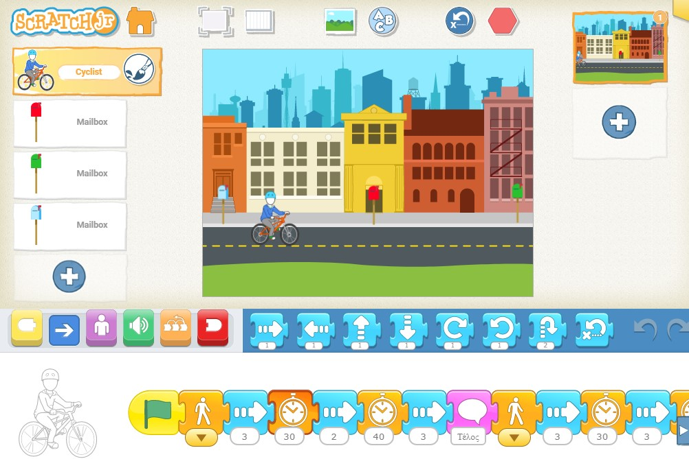
Using ScratchJr to promote Sustainable Regional Development in pre-service teachers’ education
Mastrogiannakis Stylianos, Plakitsi Katerina
University of Ioannina, Greece
ppr00137@uoi.gr, kplakits@gmail.com
INTRODUCTION
Introduction
Over the past four decades, the World have become increasingly aware of environmental problems such as depletion of the Earth’s protective ozone layer, destruction of tropical and old-growth forests and wetlands, species extinction, water contamination and declining groundwater supplies, global warming and climate change. Under the pressure of environmental destruction combined with population overgrowth, researchers have been working on finding solutions for sustainable development, which is defined by the United Nations World Commission on Environment and Development (1987) as the development that meets the needs of the present without compromising the ability of future generations to meet their own needs. Sustainable development has economic, environmental and social dimensions. Sustainable Regional Development refers to the integral community development (social, economic, environmental and healthcare, technological, cultural and recreational) on a particular territory. On the other hand, the content of science education in the early grades concerns topics such as human life, social structures and relations, life of plants and animals, sustainable development, places and people and a variety of scientific concepts. In addition, the rapid spread of STEM education has affected science curricula all over the world. In our research, we designed and carried out a course for pre-service kindergarten teachers at the University of Ioannina Department of Early Childhood Education in order to raise their awareness about sustainable regional development and investigate their views. The course consisted of two parts: becoming familiar with Scratchjr programming tool and discovering ways to use it to teach regional sustainable development in early childhood education settings.
The aim of research is to raise pre-service kindergarten teachers’ awareness and investigate their views on Sustainable Regional Development.
Objectives a) To develop teaching methods on regional Sustainable development, b) to familiarize university students with regional sustainable development techniques for better agricultural production, energy use, natural resource management, material consumption and industrial production, c) to develop university students’ ICT literacy and computational thinking.
The methods of the research. The sample was comprised of 206 university students/pre-service kindergarten teachers. They were all assigned a task involving the design of an educational scenario on teaching a specific regional development technique to early childhood students. In addition, 14 subjects of the sample were voluntarily interviewed.
Programming is considered one of the most significant literacy skills of the 21st century. It is a dynamic process that can facilitate children's cognitive development and their transition to new and higher forms of thought and expression. Previous research has shown that pre-schoolers can create programs in order to solve problems by utilizing developmentally appropriate tools.
ScratchJr is a programming environment that enables young children to program their own interactive stories, games and simulations. ScratchJr is a programming tool that takes into account the developmental needs of preschoolers, such as emerging fine motor skills, reading ability and self-regulation. ScratchJr takes advantage of the popularity of mobile devices since it is available both for smart phone devices with iOS or Android operating systems and screen sizes up to 7 inches As a cognitive-exploratory tool, it supports the creation of the student's mental models, enhances his cognitive processes such as thinking, problem solving and learning and provides the possibility for students to explore situations for the construction of knowledge.
In our research, ScratchJr enables pre-service kindergarten teachers to express their ideas on regional sustainable development through creating their own stories, games and simulations.
Fig. 1: air pollution reduction caused by the use of bicycles
O
Methods and Main findings
Theoretical background
The research sample consisted of 206 pre-service kindergarten teachers at the University of Ioannina Department of Early Childhood Education, who registered and attended a Science Education course during winter semester of 2020-21. The students were given an assignment challenging them to use ScratchJr to express their ideas on teaching sustainable regional development techniques to early childhood students in a developmentally appropriate way. Moreover, 14 subjects of the sample were voluntarily interviewed.
The researching method was a qualitative one. We conducted in-depth interviews to 14 of the students of the sample in order to gather precise data about what they believe and what their motivations are. The interviews were carried out by using digital tools of communication such as Microsoft Teams and Messenger due to COVID-19 limitations. Furthermore, the evaluation of the students’ tasks provided us with significant data referring to their ideas and views about both ScratchJr and Sustainable Regional Development.
Results has shown that pre-service kindergarten teachers generally have a positive view of the impact of ScratchJr on teaching sustainable regional development issues. Based on the data from their assignments, they tend to prefer making stories or simulations rather than games. In addition, their favorite topics in order to teach sustainable regional development techniques to early childhood students were recycling, energy saving and environmental protection.
Pre-service teachers being interviewed stressed the fact that ScratchJr is an ICT tool that assists them design new paths in promoting Sustainable Regional Development techniques and methods in pre-school education. Furthermore, they expressed a strong desire to use ScratchJr in a kindergarten classroom in order to apply their new skills. Their main concerns involved the kindergartens’ infrastructure on tablets.
MAIN RESULTS AND CONCLUSIONS
ScratchJr seems to positively contribute to the development of pre-service kindergarten teachers’ skills in teaching sustainable regional development techniques to early childhood students. From the consideration of research data, pre-service teachers seem to believe that ScratchJr is a programming tool that assists them to design and carry out a science lesson regarding to sustainable regional development issues.
Also, study’s results, revealed that pre-service teachers are eager apply their new ICT skills in real kindergarten classroom settings. Based on these findings, we believe that not only ScratchJr is appropriate to function as an introduction to basic programming concepts and Computational Thinking but as well as an ICT tool for teaching Sustainable Regional Development issues in pre-school education.

