Slide 1
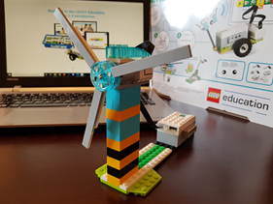
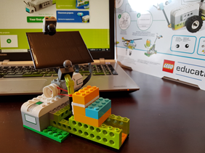
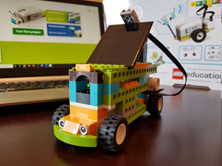
Educational Robotics and Sustainable Regional Development: A case study in Primary Education
Koukoulis Georgios, Plakitsi Katerina
University of Ioannina, Greece
g.koukoulid@uoi.gr, kplakits@gmail.com
INTRODUCTION
Introduction – Research Problem
The citizens of the region face a number of challenges related to environmental, economic and social injustice. To overcome this sustainable development problem, some new regional practices need to be adopted and some of the 21st century skills need to be developed. To ensure the long-term prosperity of the region, the role of education is essential. New tools as educational robotics can be used as strong mediative tools to teach natural sciences in order to raise the awareness about sustainable regional development and develop new skills.
The aim of research
The aim of the research is to enable students to realize what regional sustainable development is and at the same time to develop their digital and ICT skills.
Objectives
to know ways of producing energy without polluting the environment
to adopt environmentally friendly habits
to develop computational algorithmic thinking
The methods of the research
An action research was carried out on 70 elementary school students. The students' work and the teacher's diary were used as data for processing and analysis.
Theoretical background
The role of education is essential in sustainable regional development. At the same time, the educational system provides a variety of ICT tools that can help for this purpose if used under an educational framework to have remarkable results.
In the present research, the uses of robotics in education are divided into two categories:
as an independent cognitive tool in order to develop computational thinking
as a means of knowledge, research and learning where it is used in cognitive subjects of sustainable development
In all educational activities the tools were used in a collaborative way by the students. The students built and programmed robots. At the same time, they presented the way they contribute to tackling the problem.
Students suggested renewable energy as a solution to the problem. They simulated a wind turbine and a solar panel with robotic tools. At the same time, they proposed transportation by vehicles that use solar energy.
Students' constructions are shown in the figures below
Wind generator Solar panel
Solar bus
Main findings
The research sample consisted of 70 primary school students in grades 4th, 5th and 6th. The students were divided into 35 boys and 35 girls.
Research has shown that educational robotics and programming tools have a positive effect on the learning process in primary education. The students used the tools in a pleasant way because they are playful and creative
The students realized that some of the factors responsible for the greenhouse effect are the greenhouse gases emitted by non-renewable energy sources and transportation. The energy production from the sun and the wind in the regions of Greece are feasible and efficient solutions due to the prevailing weather conditions. The solutions proposed and implemented by the students with the robotic constructions contribute to the preservation of the environment. in addition, the environmentally friendly means of transport contribute to a beautiful image of the region.
The students worked in groups of four. The members of each group had different tasks. Two students undertook the construction of the robot while the other two undertook its programming. The collaboration between the members was necessary because the two aforementioned tasks could not be done individually as the programming is based on the structure of the robot but also the construction is based on the programming capabilities.
The research has shown that educational robotic tools provide opportunities for active participation of students. The interactions between the participants and the mediation of these tools led to the integrated approach of the topic, bringing to the surface pre-existing knowledge of the students which were supplemented or transformed into the new desired ones. The presentation of the constructions in the classroom and the discussion helped in their externalization.
MAIN RESULTS AND CONCLUSIONS
From the analysis of the students' work and teacher’s diary it became clear that robotic tools helped the students to develop computer skills and the teacher to design science lessons. Educational robotics tools contribute effectively to the development of algorithmic thinking in primary school students. In addition, they provide a collaborative environment for participants interaction.
Furthermore, they helped students to be informed about sustainable regional development. The playful character mobilized them to actively participate in it by proposing and constructing solutions. The solutions they proposed were environmentally friendly and offered opportunities for regional development. Finally, the students understood that economic and social development must go hand in hand with sustainable development.
Based on these results it is understood that robotics can contribute both to acquire computer skills and awareness about sustainable regional development.

